Slide 1
Overview of distance measurements

Slide 2
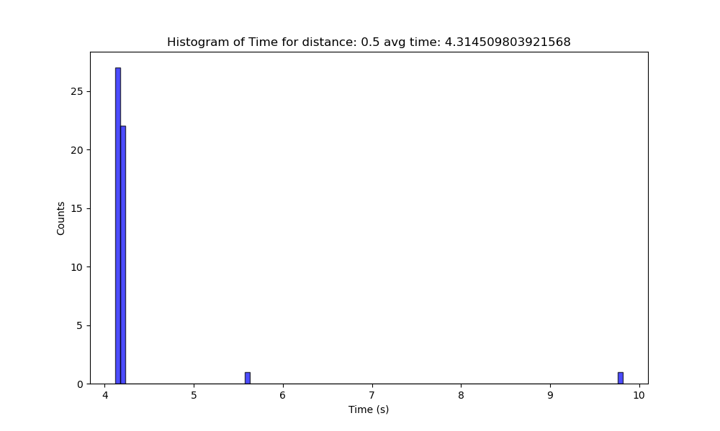
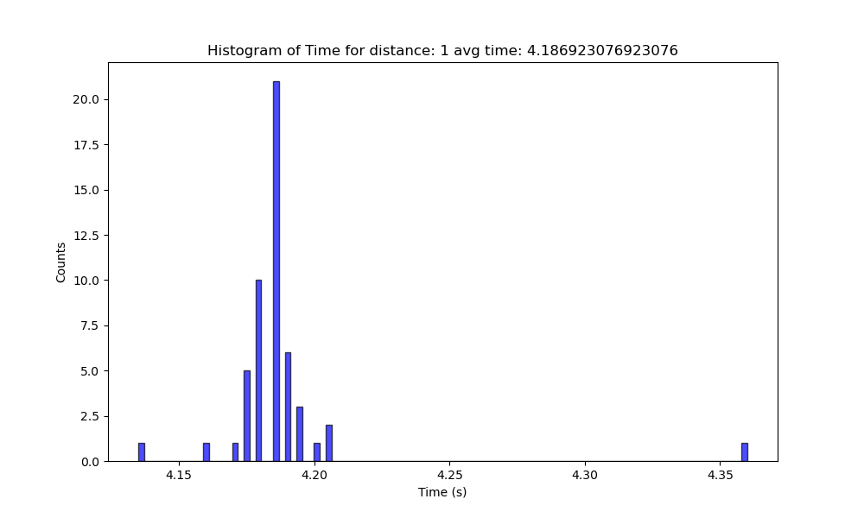
1V – 0.5/1

Slide 3
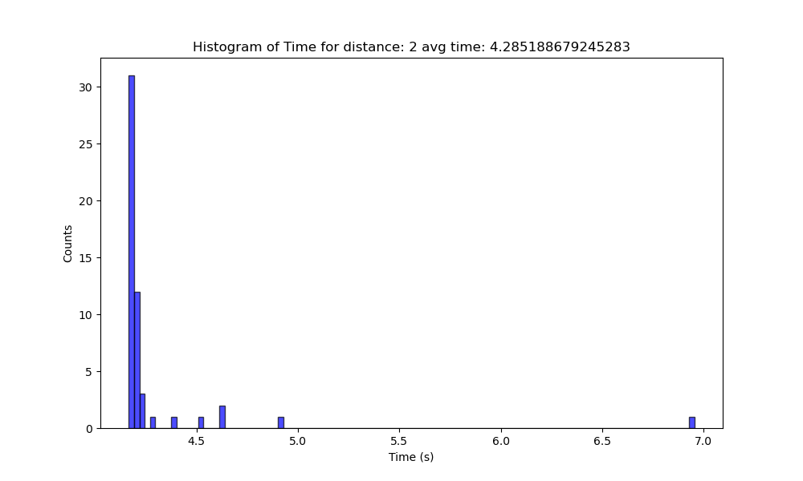
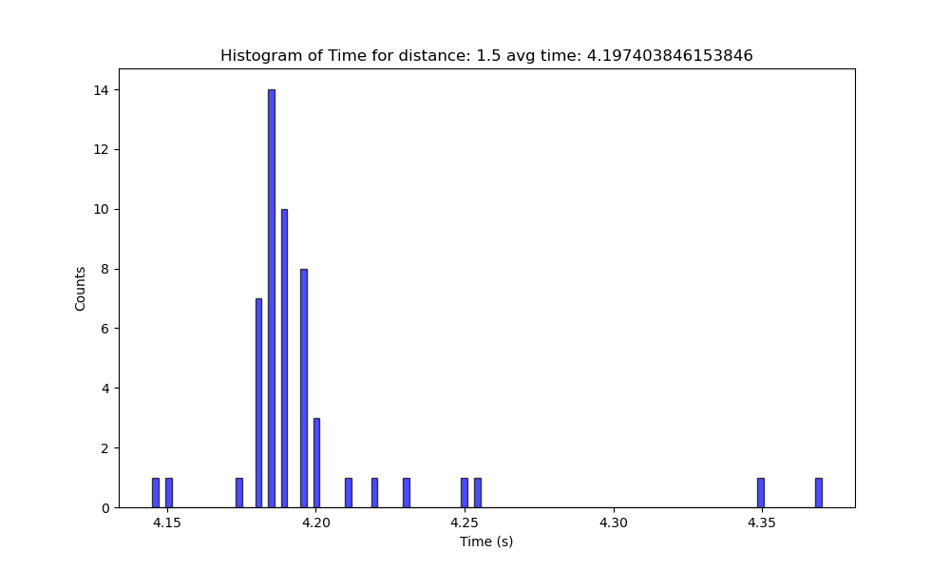
1V – 1.5/2

Slide 4
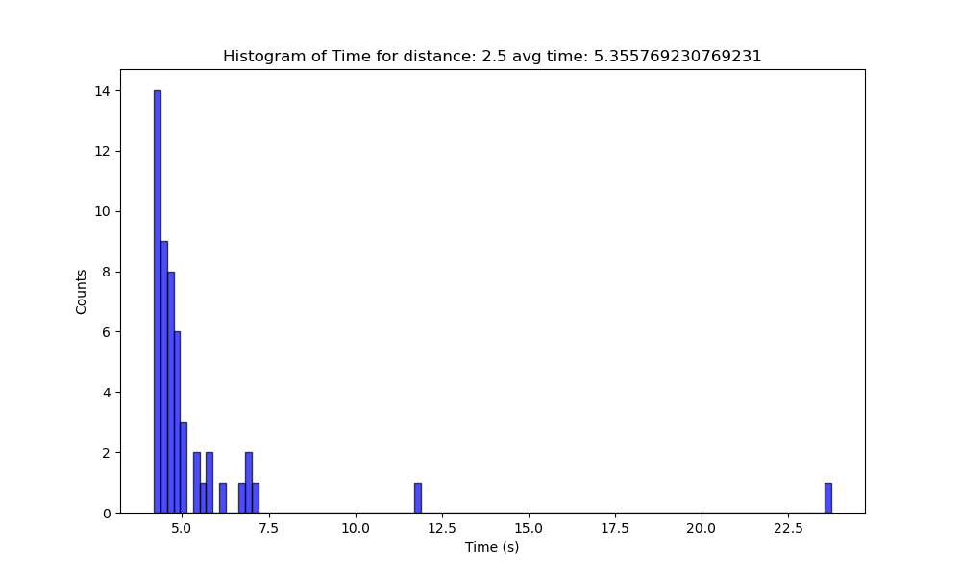
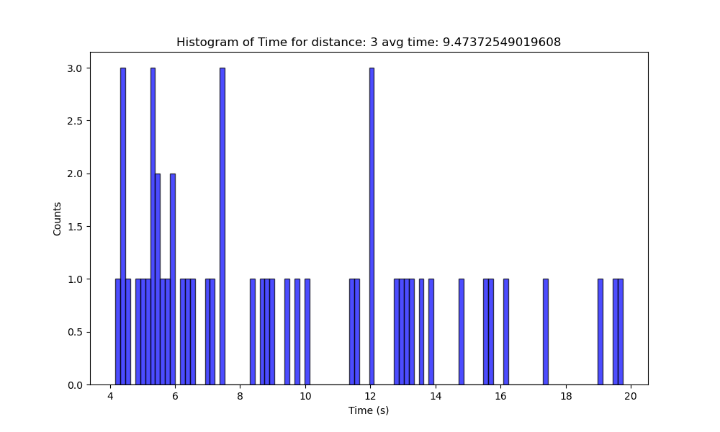
1V – 2.5/3

Slide 5
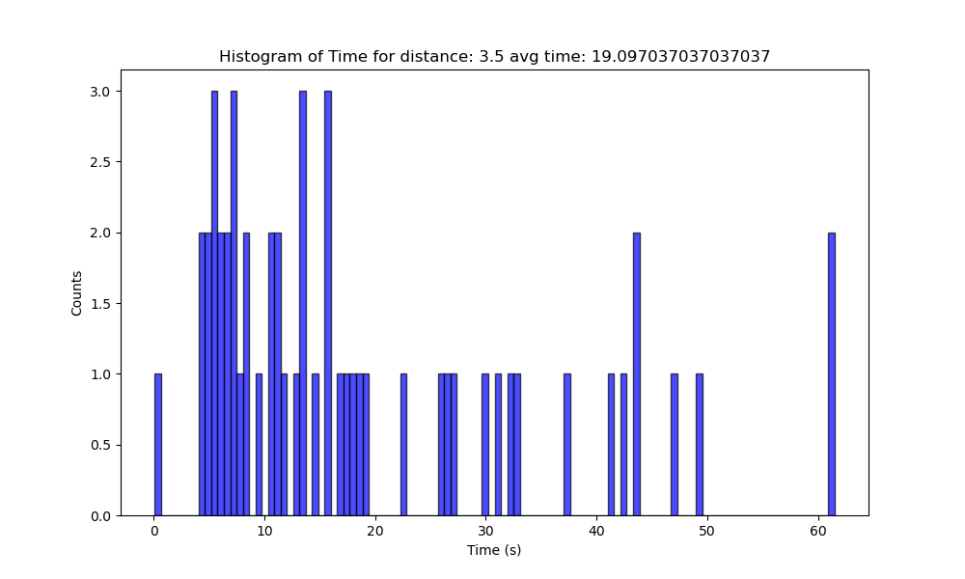
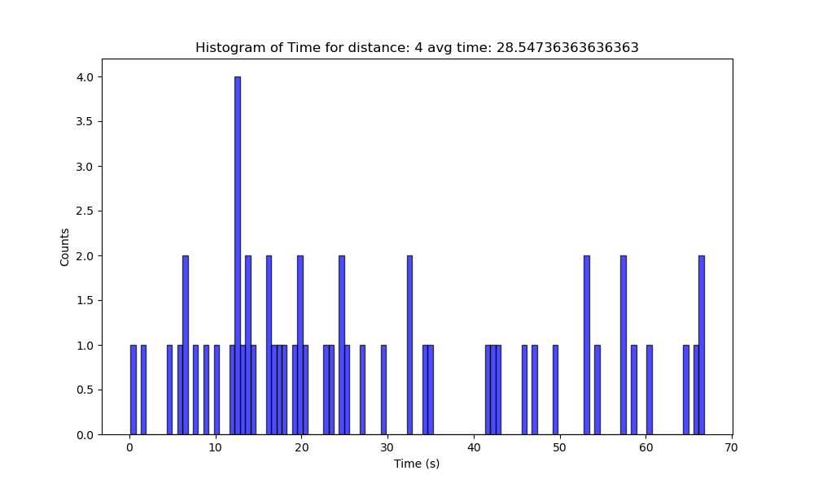
1V – 3.5/4

Slide 6
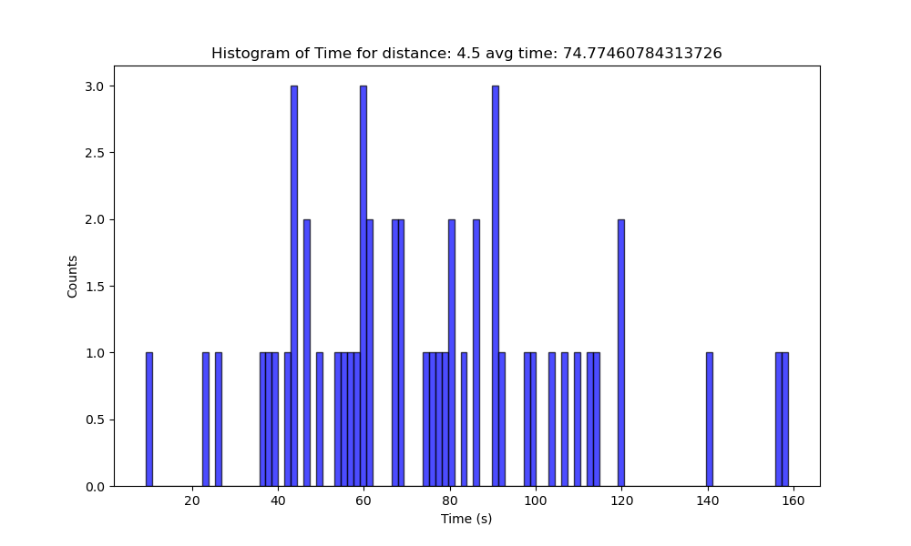
1V 4.5

Slide 7
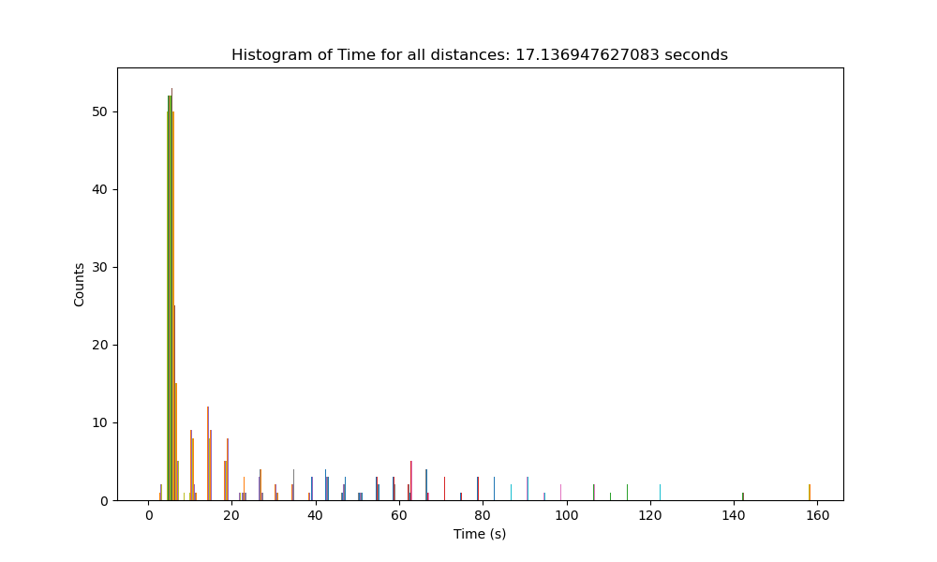

Slide 8
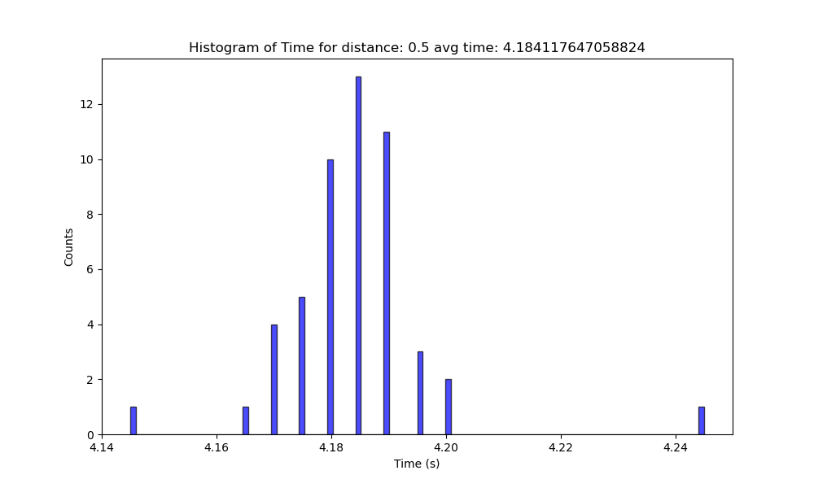
900mV 0.5/1

Slide 9
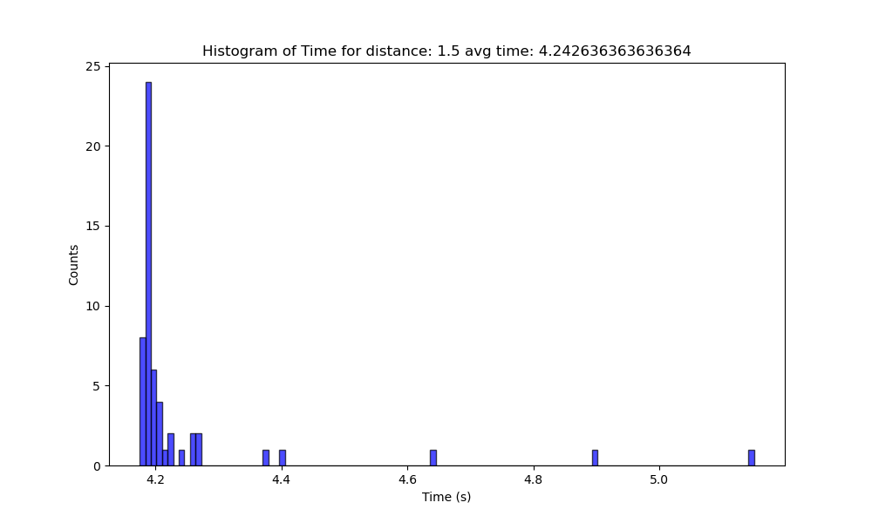
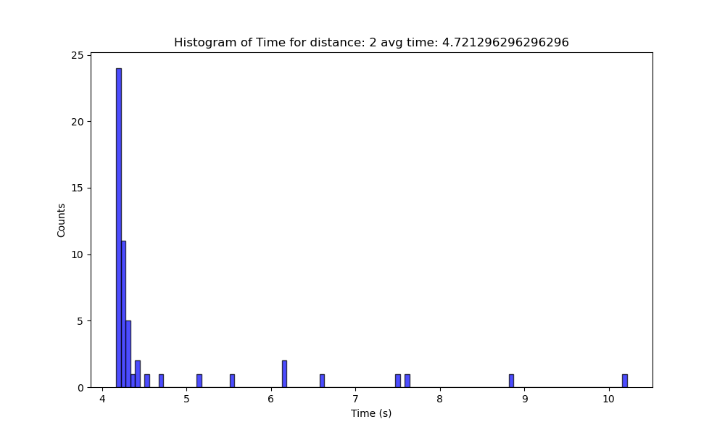
900mV 1.5/2

Slide 10
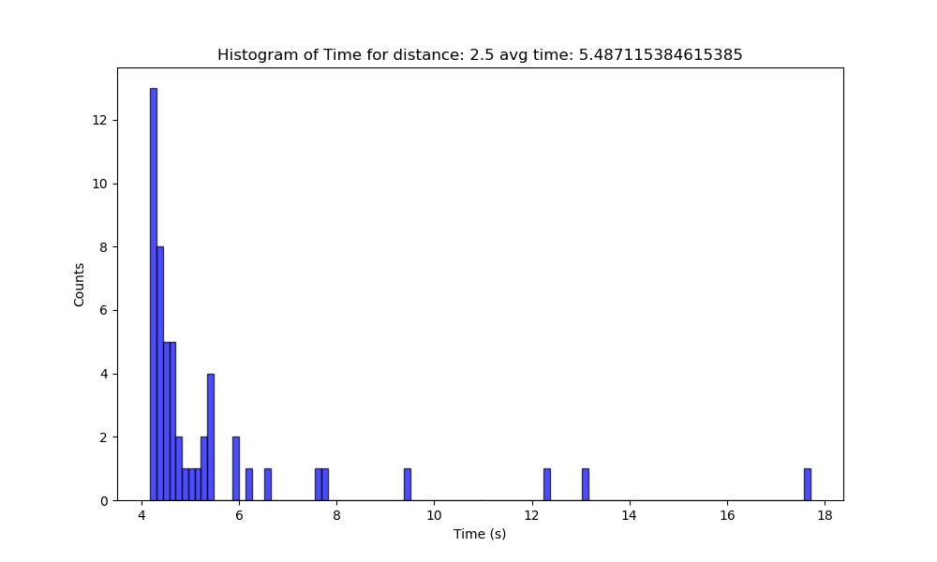
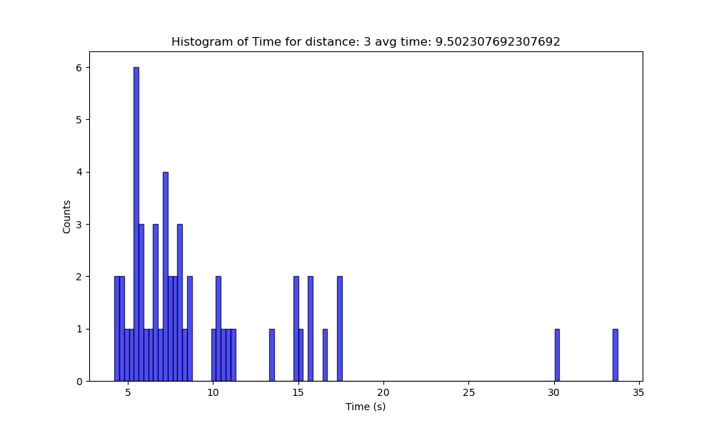
900mV 2.5/3

Slide 11
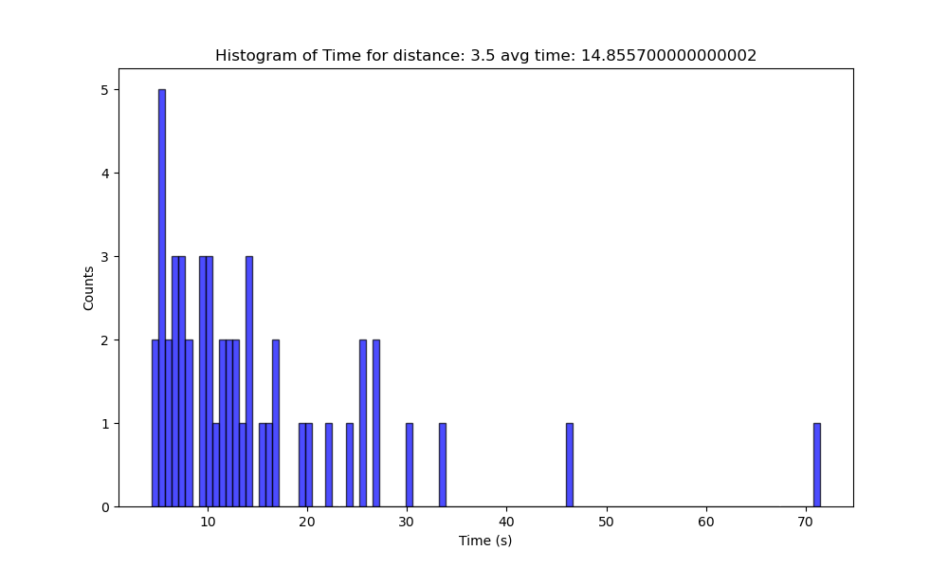
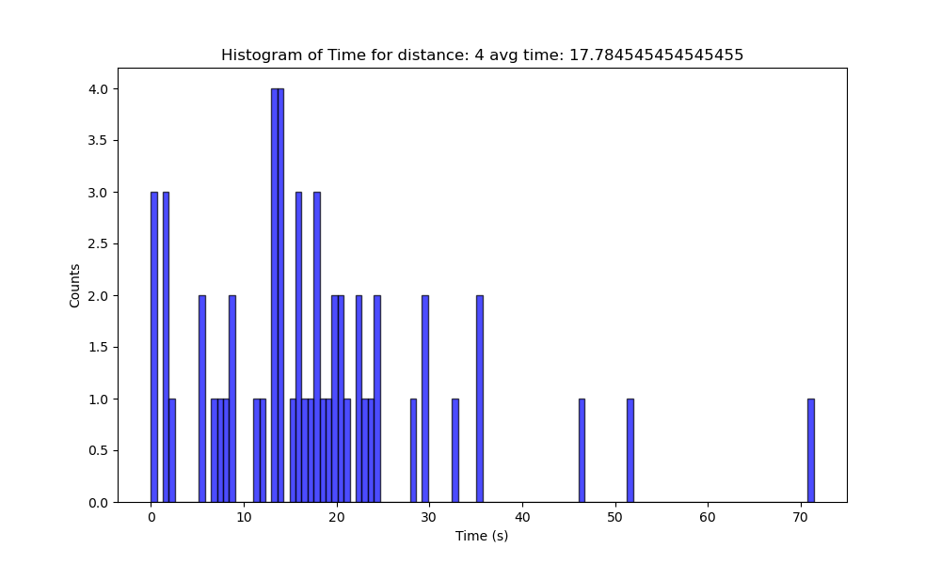
900mV 3.5/4

Slide 12
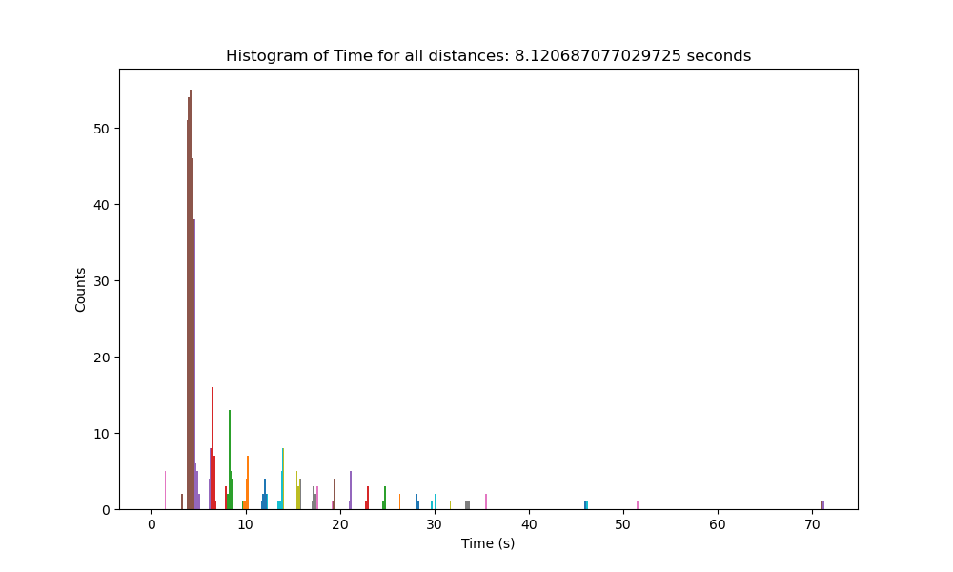

Slide 13
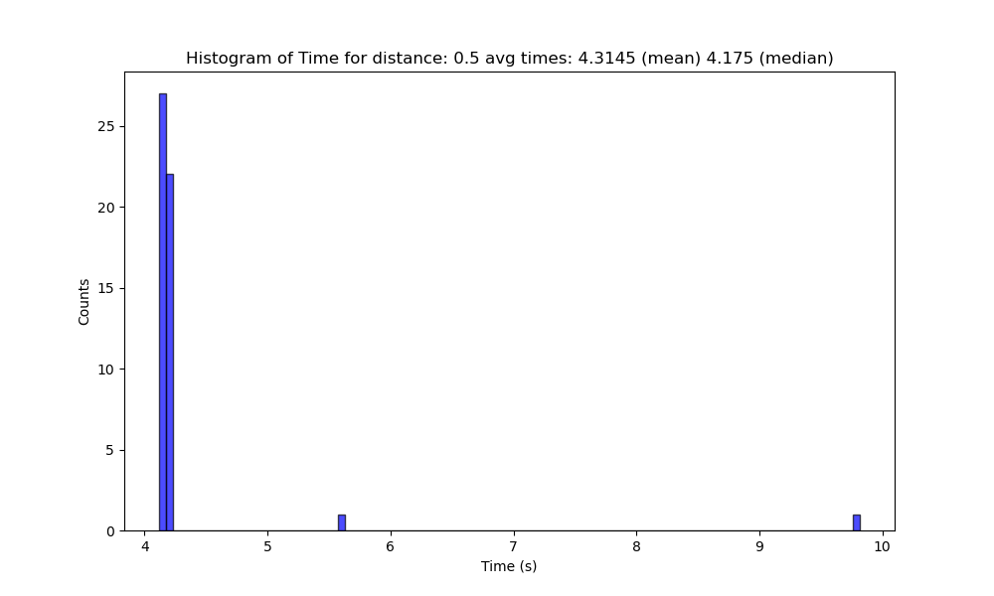
0.5nm
1V 900mV

Slide 14

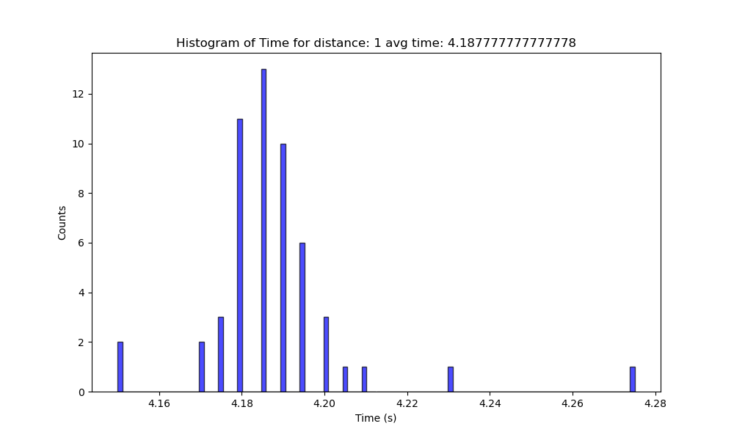
1nm
1V 900mV

Slide 15

1.5nm
1V 900mV

Slide 16
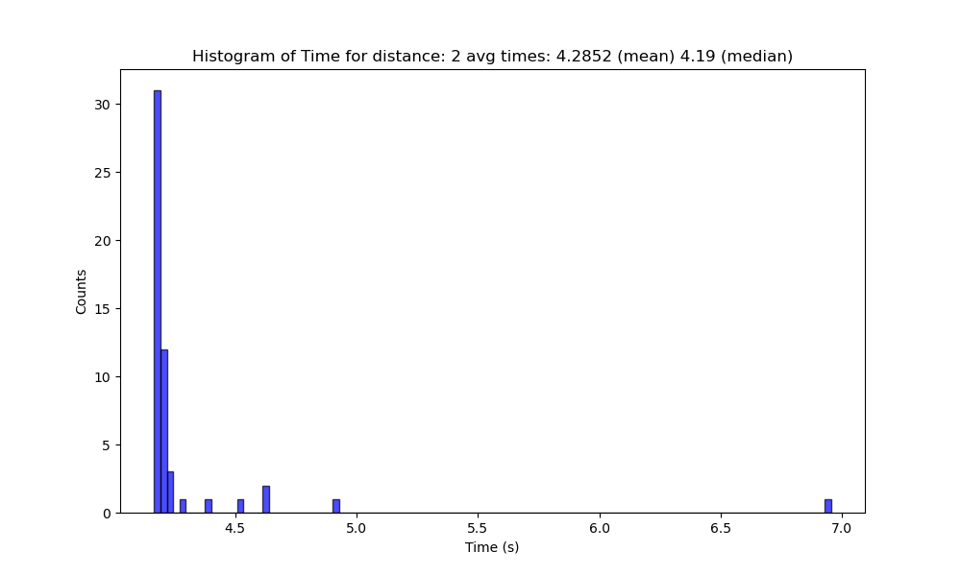
2
1V 900mV

Slide 17

2.5
1V 900mV

Slide 18

3
1V 900mV

Slide 19

3.5
1V 900mV

Slide 20
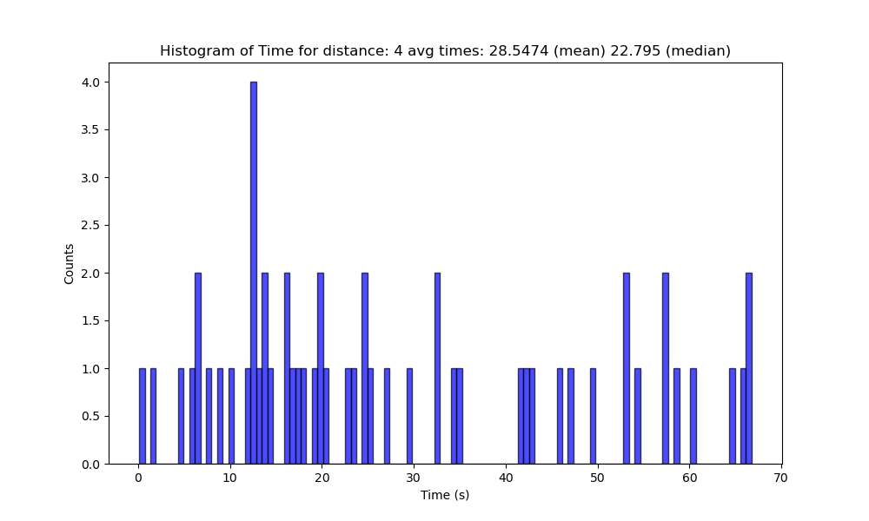
4
1V 900mV

Slide 21
Left – 1V
Bottom – 900mV

Slide 22
Negative distance mean NW compared with total piezo range. For similar images of the time it was about 45deg to island growth.\

Slide 23
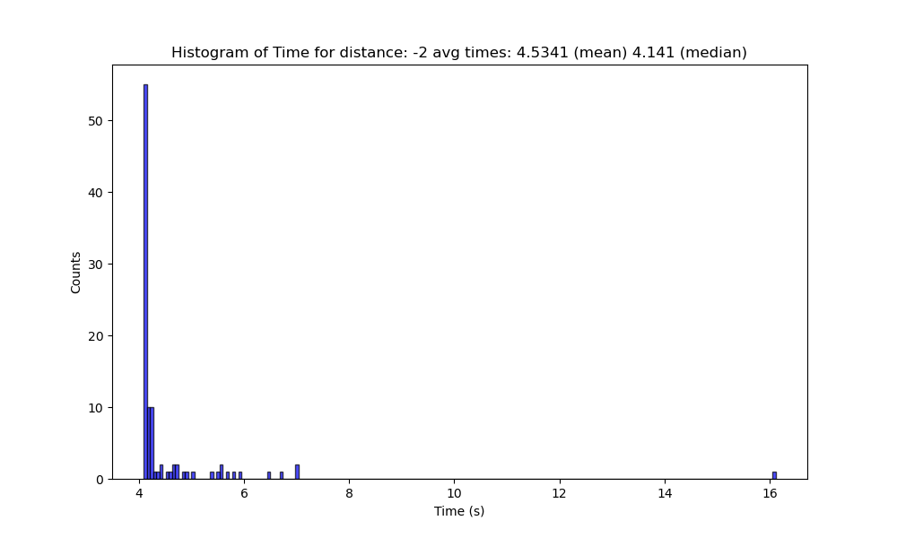
2/-2

Slide 24
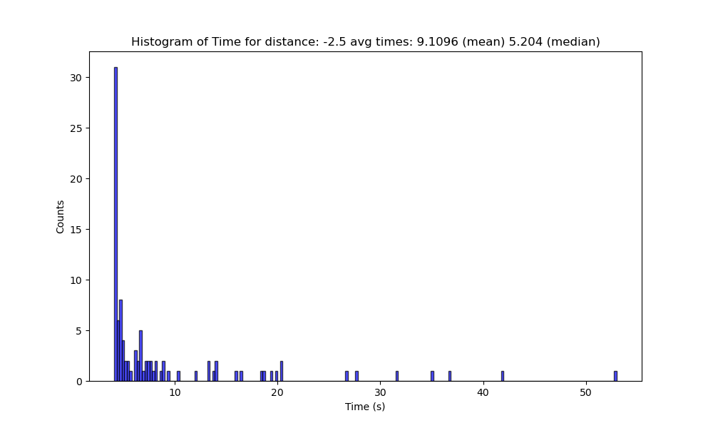
2.5/-2.5

Slide 25
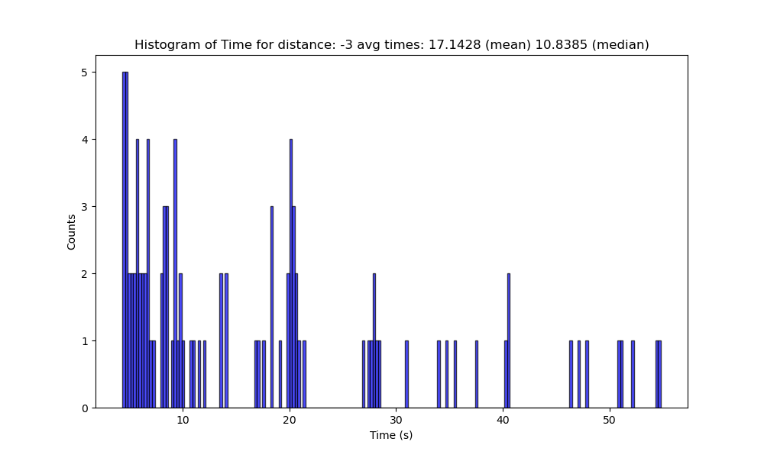
3/-3

Slide 26
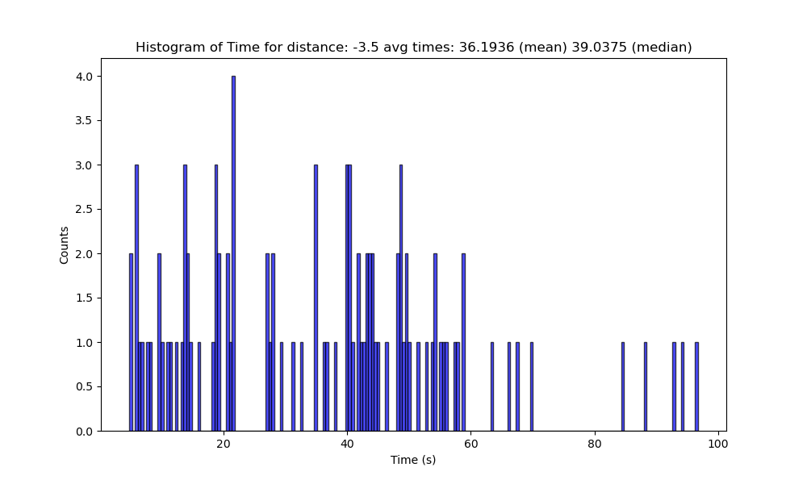
3.5/-3.5

Slide 27
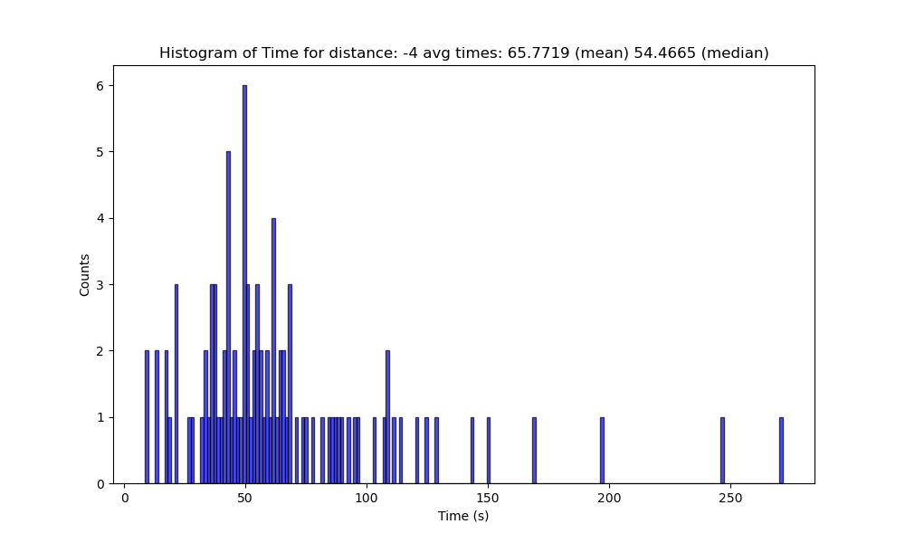
4/-4

Slide 28

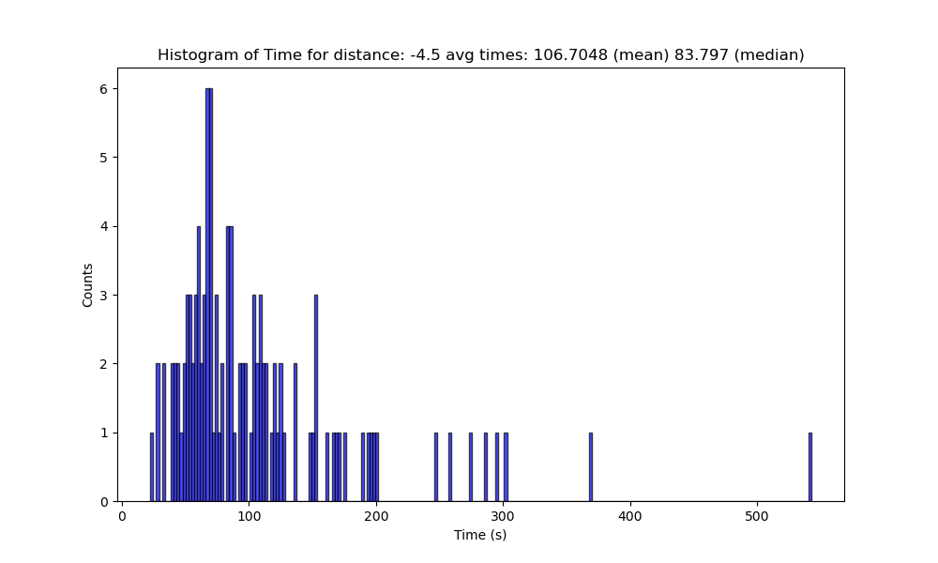
4.5/-4.5

Slide 29
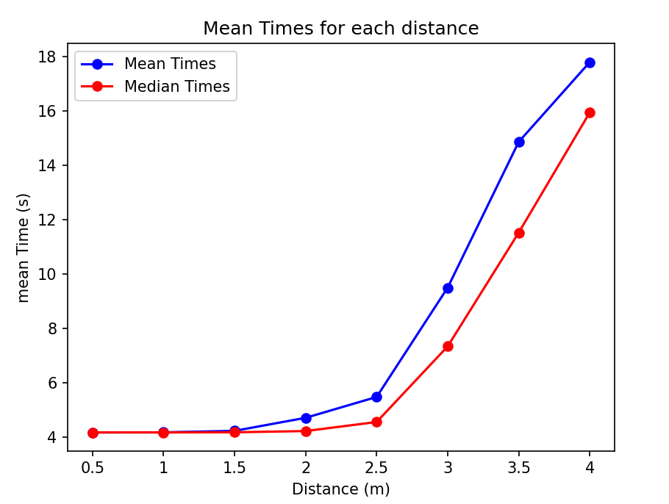
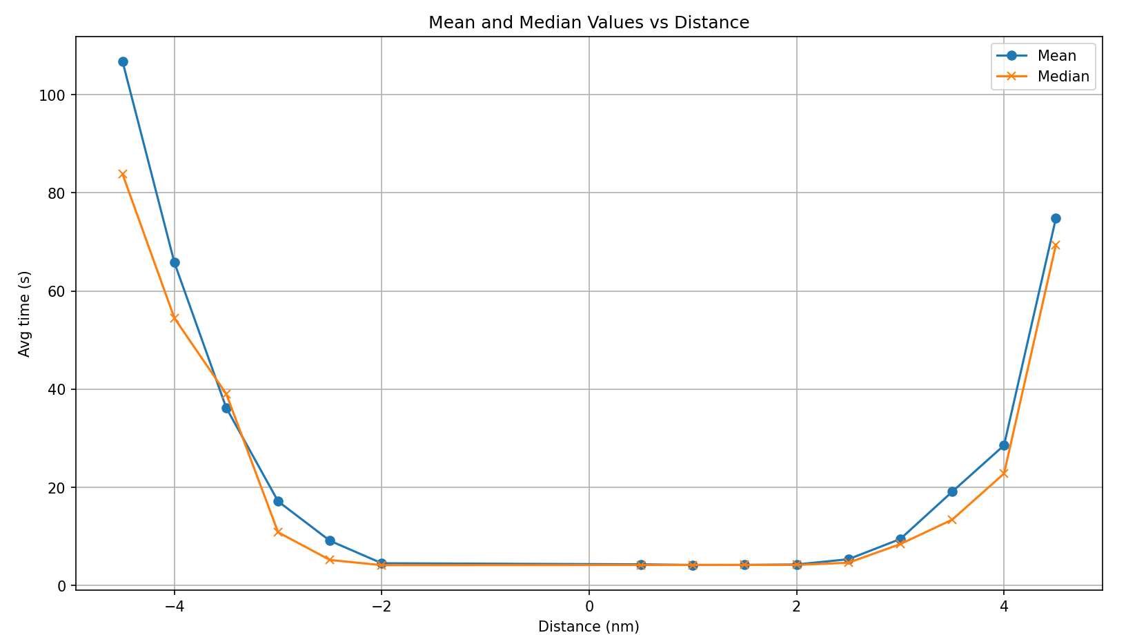
avg times -> 900
Below is 1V

Slide 30
900mV avg ties

Slide 31
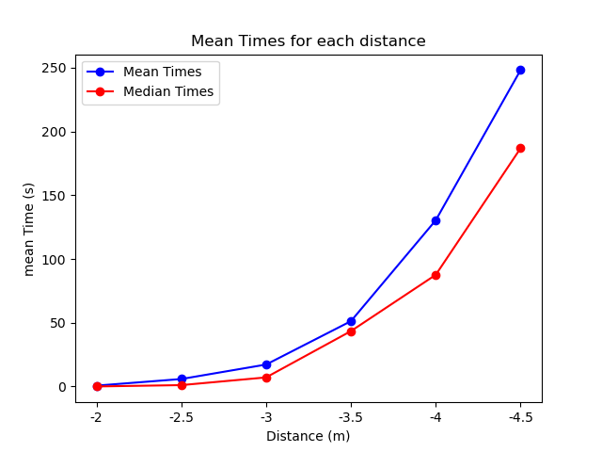
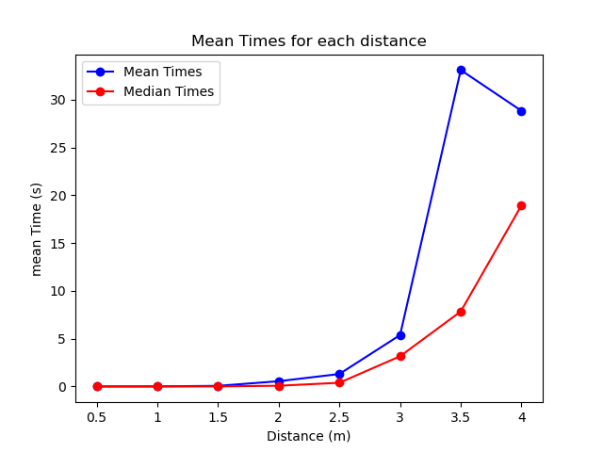
Changed analysis to find to get to distance
900mV
1V

Slide 32
DIAGRAMS FOR REPORT

Slide 33
A
Distance
B
Wait for movement
C

Slide 34
A
View from top
B
View from side
C
Sweeps

Slide 35
A
Up-down
B
C

Slide 36
A
Gating
B
C
D

Slide 37
UPDATED STUFF WITH NEW HISTOGRAMS

Slide 38
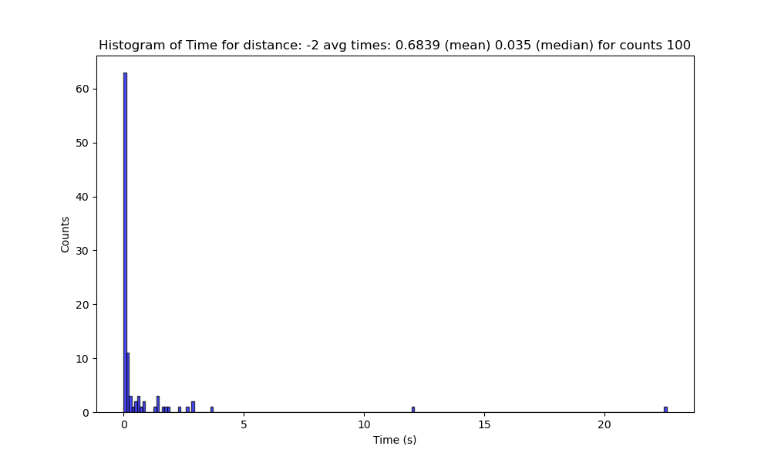
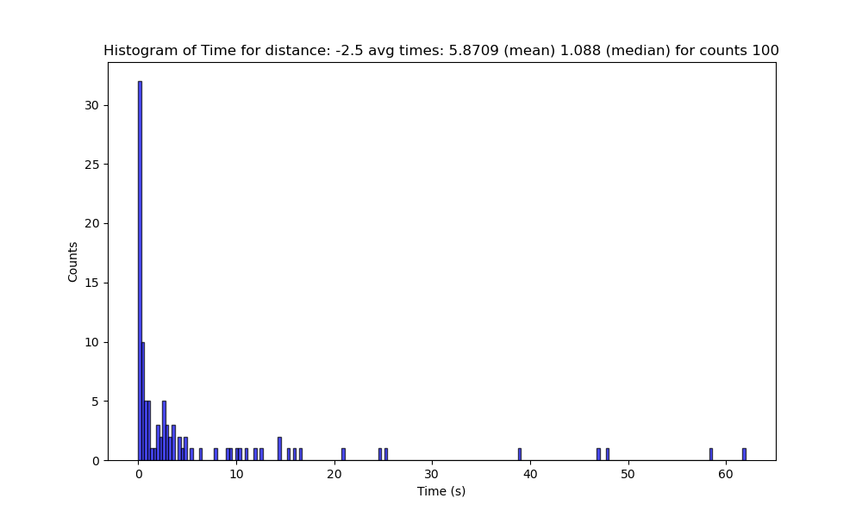
-2/-2.5

Slide 39
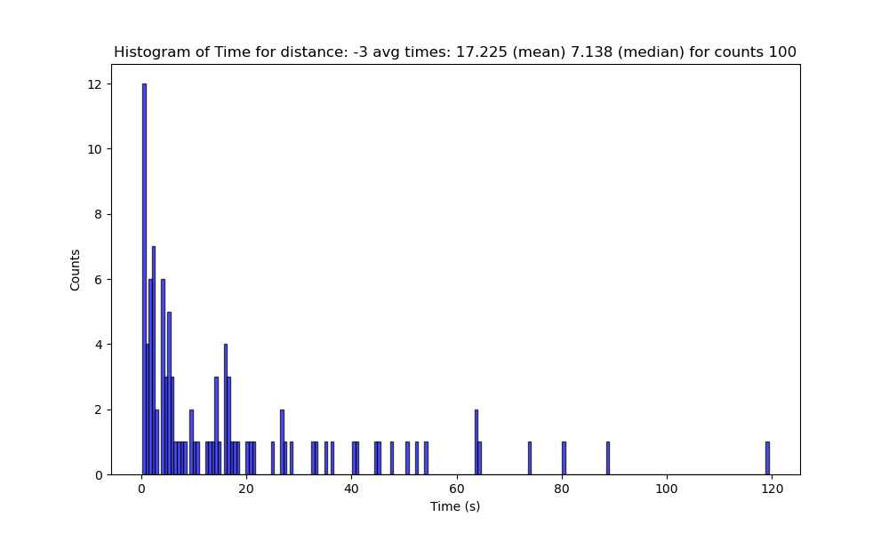
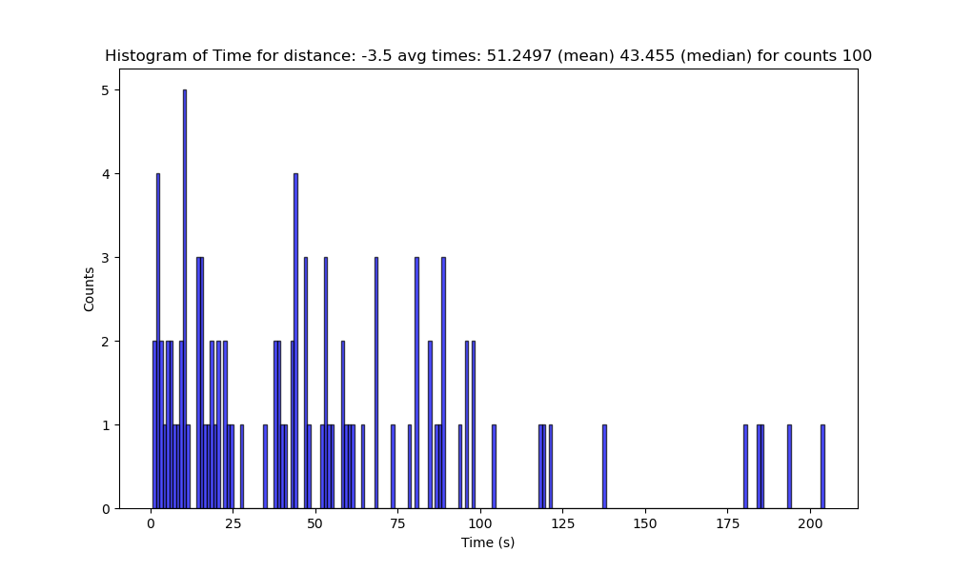
-3/-3.5

Slide 40
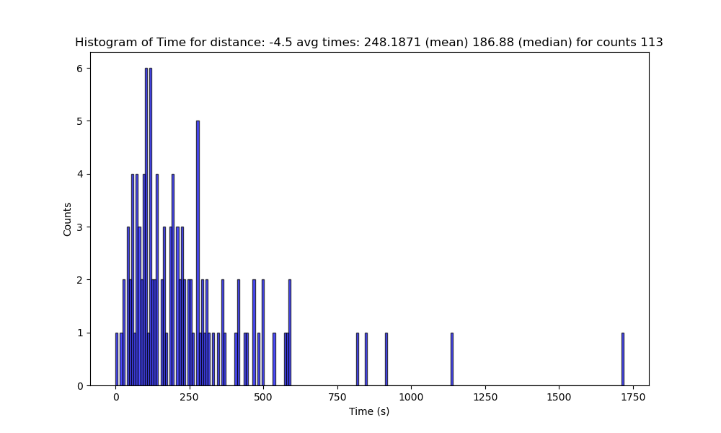
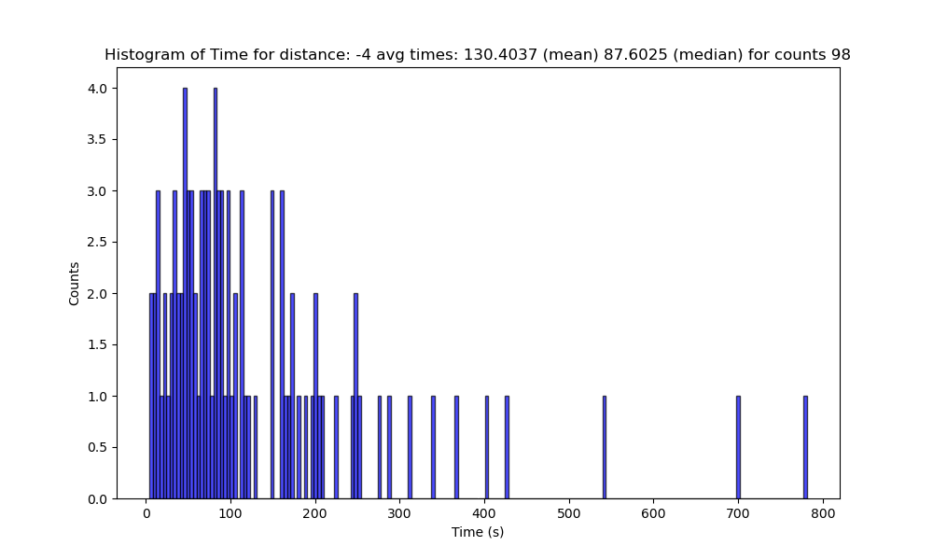
-4/-4.5

Slide 41
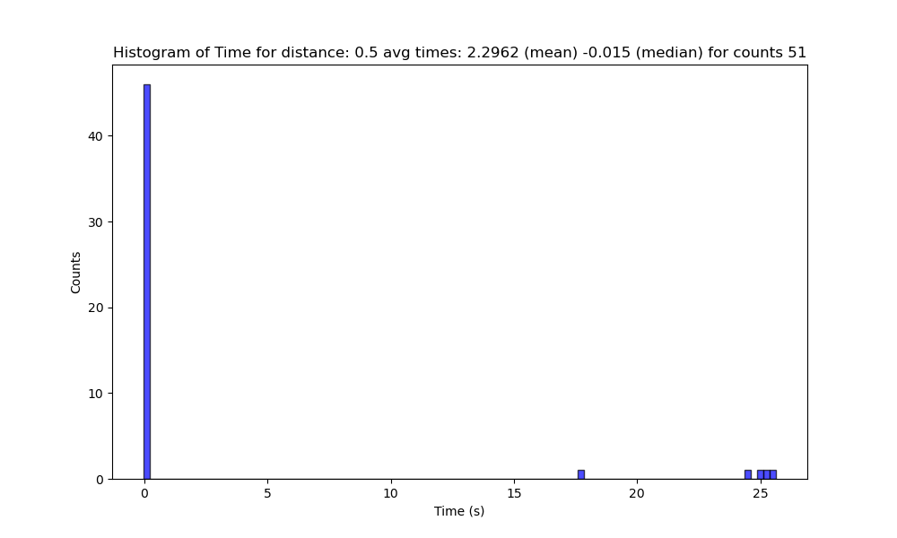
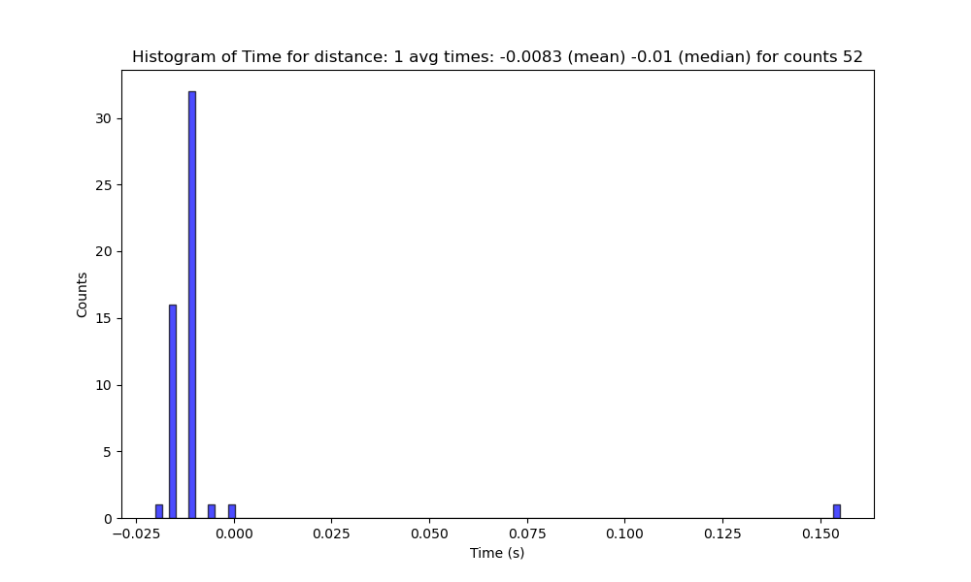
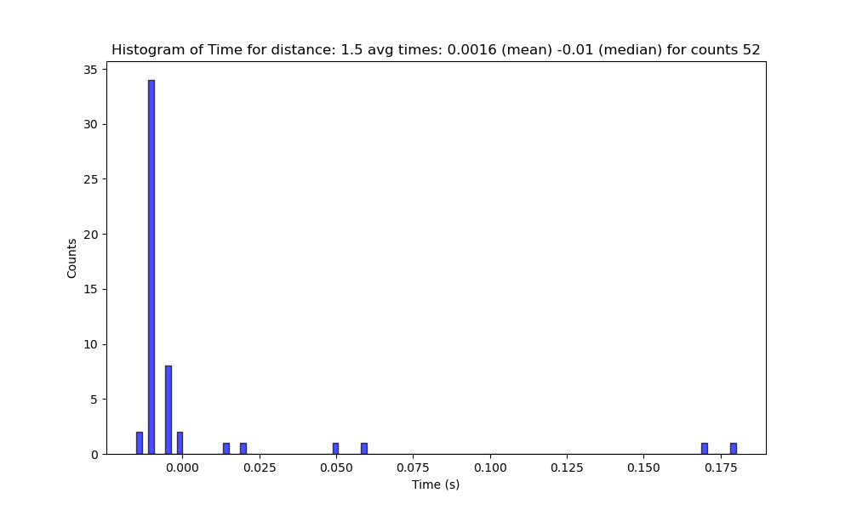
0.5/1/1.5

Slide 42
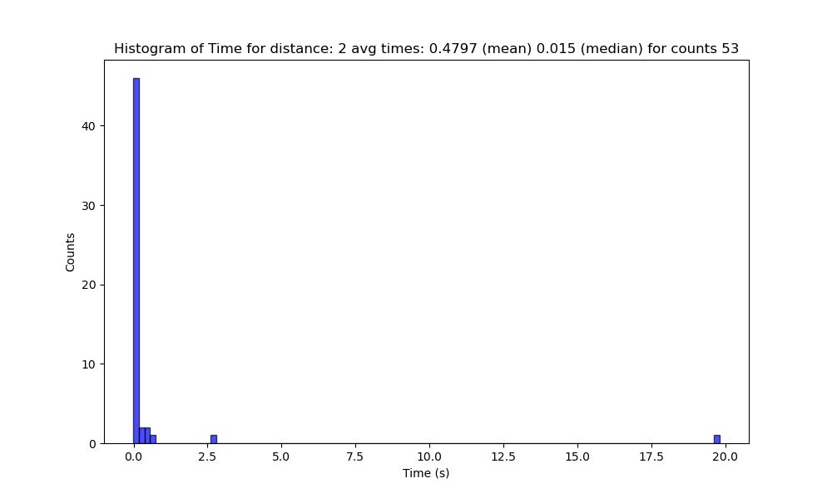
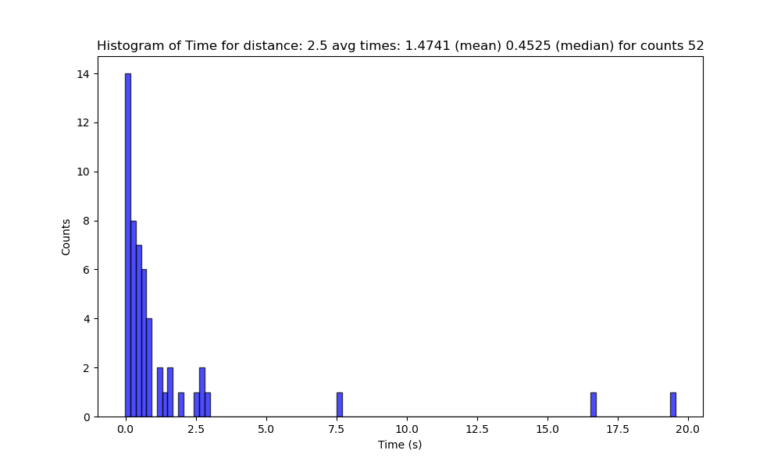
2/2.5

Slide 43
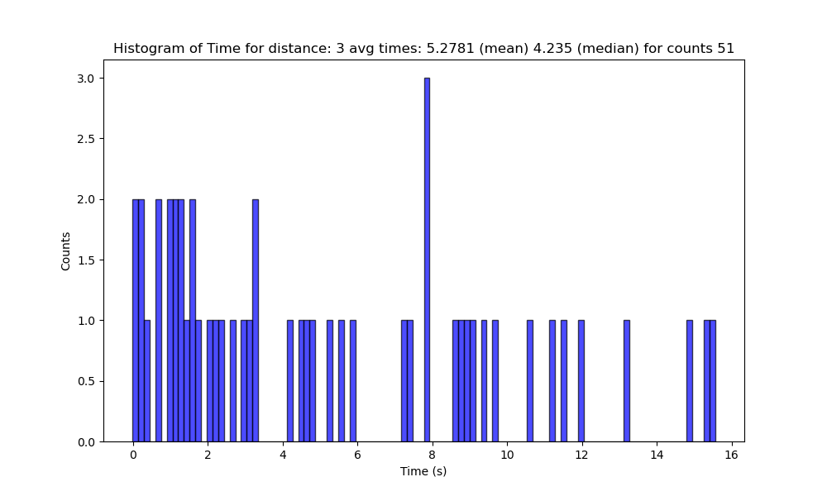
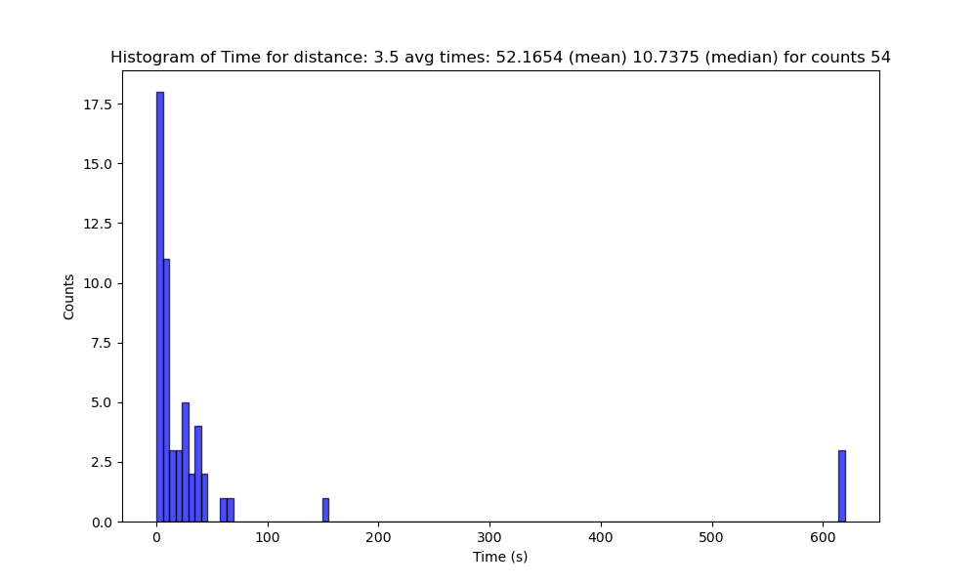
3/3.5

Slide 44
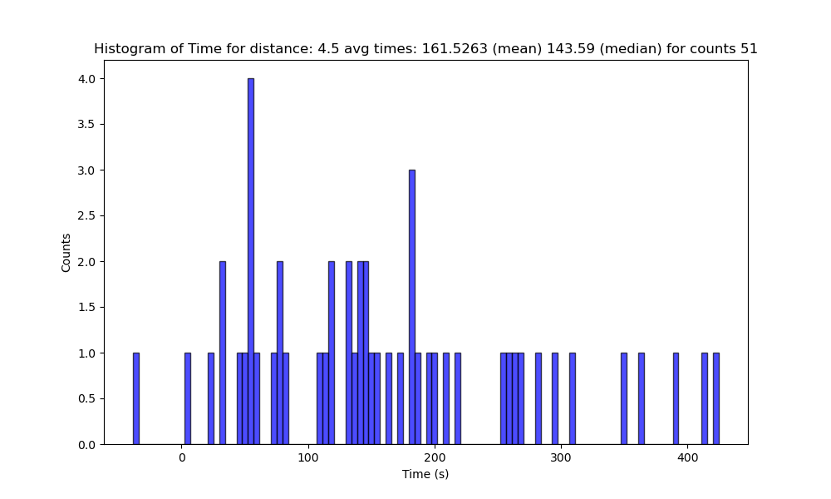
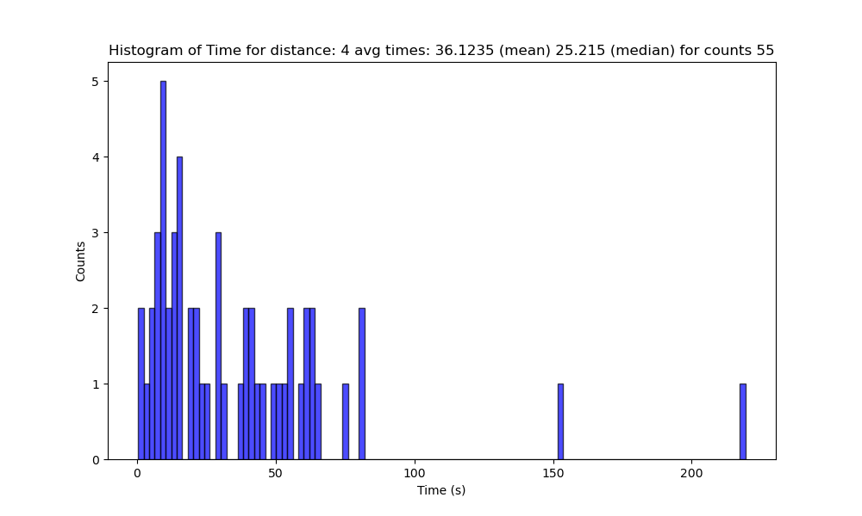
4/4.5

